Slide 1
FIRST 5
A class of students has measured their heights.
146, 148, 151, 153, 153, 154, 155, 156, 156, 156, 157, 157, 159, 162, 162, 162, 163, 164, 164, 165, 165, 168, 168, 173, 174, 177, 181.
Find the mean
Find the Mode
Find the median
Find the range
Is there an outlier?Yes/No
Mean = 161.0740741
Mode = 156
Median = 162
Range = 35
Outlier No
How could we present this information diagrammatically?

Slide 2
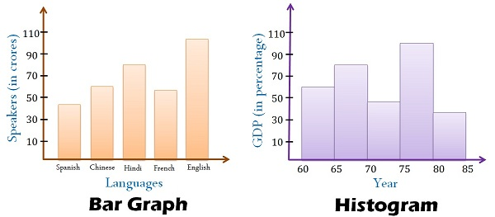
Today’s lesson is about histograms.
A histogram looks a lot like a column graph but there are a couple of key differences.
Gaps
No Gaps
Data is categorical and bars can be swapped around
Data is continuous numerical and columns cannot be swapped around

Slide 3
24
7
30
Histograms
Date
EQ – What steps do I follow to create a histogram?
What is a histogram?
A histograms shows the frequency of continuous numerical data.
Notes:
iler

Slide 4
24
7
30
Histograms
Date
EQ – What steps do I follow to create a histogram?
What is a histogram?
A histograms shows the frequency of continuous numerical data.
List the steps to create a histogram?
Look at the range of the data to help decide on a “class width”.
Lets look at the data we used for the warm up.
146, 148, 151, 153, 153, 154, 155, 156, 156, 156, 157, 159, 162, 162, 162, 163, 164, 164, 165, 165, 168, 168, 173, 174, 177, 181.
The range was found to be 35.
I want to create a histogram with between 5 and 20 “classes” (or columns). If you can choose a class width using a number that is easy to calculate with. A class width of 10 creates only 4 classes, while a class width of 5 (starting at 145) creates 8 classes. A class width of 2 is possible but will create 16 classes many of which will have only 1 or 2 results in them.
Notes:
iler

Slide 5
24
7
30
Histograms
Date
EQ – What steps do I follow to create a histogram?
What is a histogram?
A histograms shows the frequency for continuous numerical data.
List the steps to create a histogram?
Look at the range of the data to help decide on a “class width”.
Use the class width to create a frequency table.
We have decided to use class widths of 5. Lets create a frequency table from our data.
146, 148, 151, 153, 153, 154, 155, 156, 156, 156, 157, 157, 159, 162, 162, 162, 163, 164, 164, 165, 165, 168, 168, 173, 174, 177, 181.
145 – 149
150 – 154
155 – 159
160 – 164
165 – 169
170 – 174
175 – 179
180 – 184
|| = 2
|||| = 5
||||| = 6
||||| = 6
|||| = 4
|| = 2
| = 1
| = 1
Notes:
iler

Slide 6
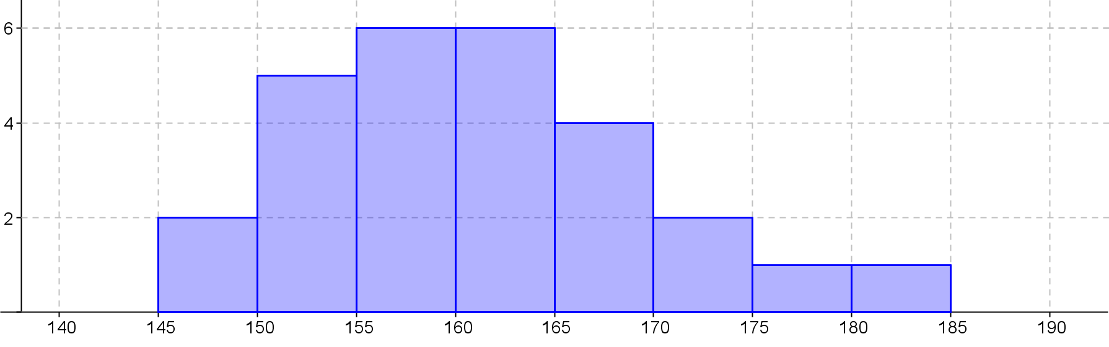
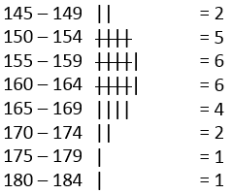
24
7
30
Histograms
Date
EQ – What steps do I follow to create a histogram?
What is a histogram?
A histograms shows the frequency for continuous numerical data.
List the steps to create a histogram?
Look at the range of the data to help decide on a “class width”.
Use the class width to create a frequency table.
Create a set of Axis that will accommodate all the data we wish to show.
Frequency
Our maximum frequency is 6 so our y axis must go to at least 6 and we use our class widths to determine the x axis
Height(cm)
Notes:
iler

Slide 7
24
7
30
Histograms
Date
EQ – What steps do I follow to create a histogram?
What is a histogram?
A histograms shows the frequency for continuous numerical data.
List the steps to create a histogram?
Look at the range of the data to help decide on a “class width”.
Use the class width to create a frequency table.
Create a set of Axis that will accommodate all the data we wish to show.
Use the frequency data from the frequency table to complete the graph and add a title.
Heights of students in 8-7
Title
Frequency
No Gaps between the columns
Labels
Height(cm)
Notes:
iler

Slide 8
24
7
30
Date
Histograms
EQ – What steps do I follow to create a histogram?
Heights of students in 8-7
Title
Frequency
No Gaps between the columns
Height(cm)
Labels
Scale
How the data looks in a histogram is important and can be described in main ways
Notes:
iler

Slide 9
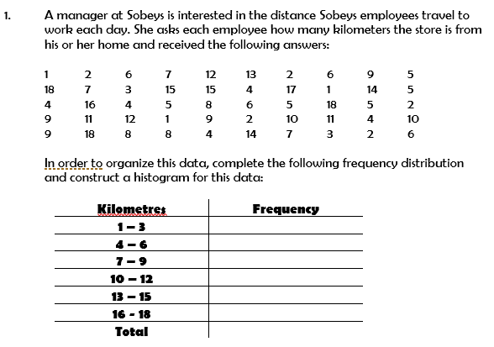
Let’s Try Together….
10
14
10
6
5
5
50

Slide 10

Let’s Try Together….
10
14
10
6
5
5
50

Slide 11
Complete histogram worksheet

Slide 12
Sentence Frame- WICOR
Summary:
Histograms display______________________________ data without any _______________.
To create histograms we need to decide on appropriate _________________ and then create a ______________ table.
EXIT PASS, completed summary allows you to leave the class.
Notes:
Histograms display continuous numerical data without any gaps. To create histograms we need to decide on appropriate class width sizes and then create a frequency table.

